Slide 1
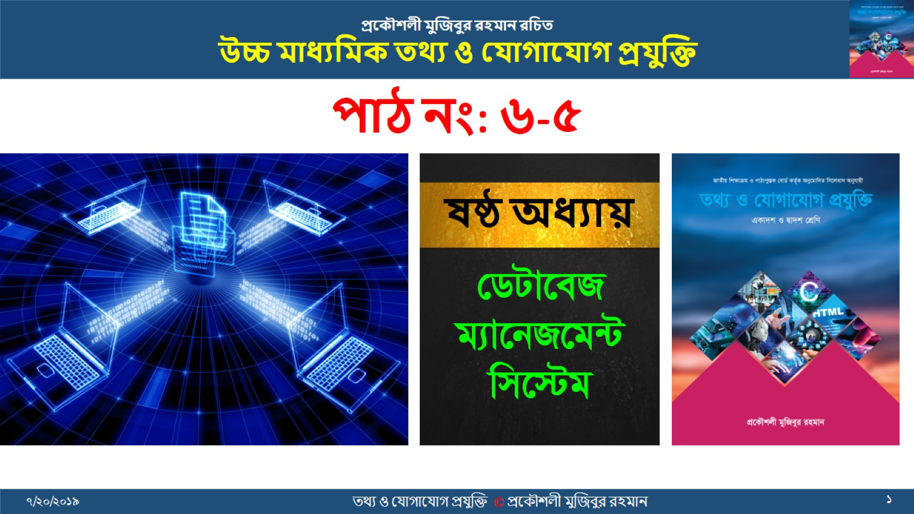

Slide 2
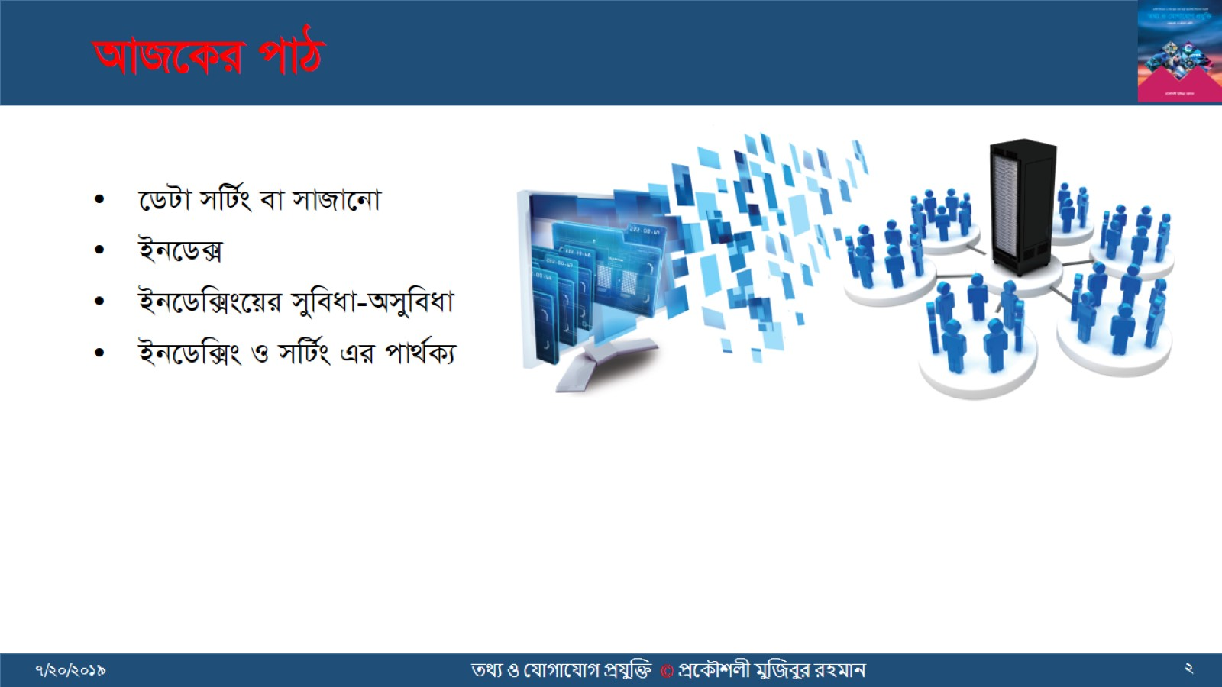
AvR‡Ki cvV

Slide 3
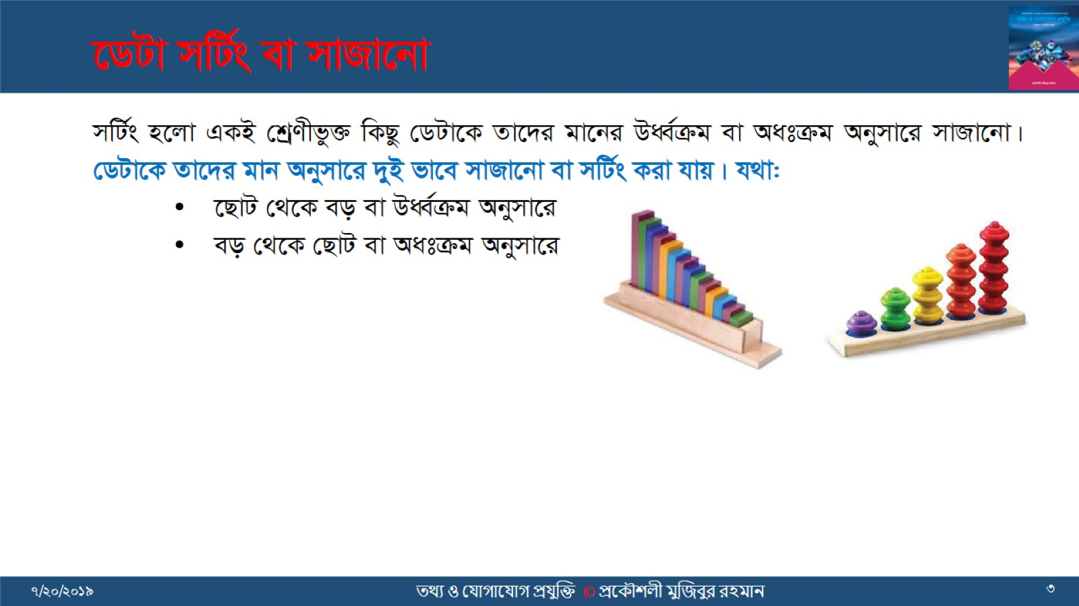
‡WUv mwU©s ev mvRv‡bv

Slide 4
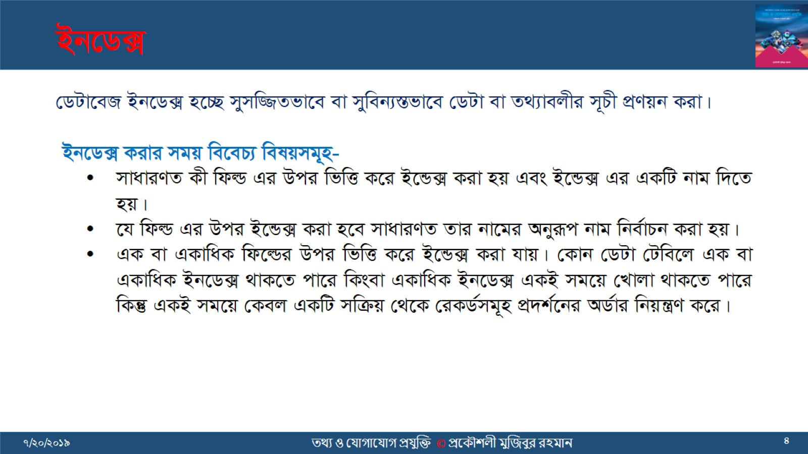
Bb‡W·

Slide 5
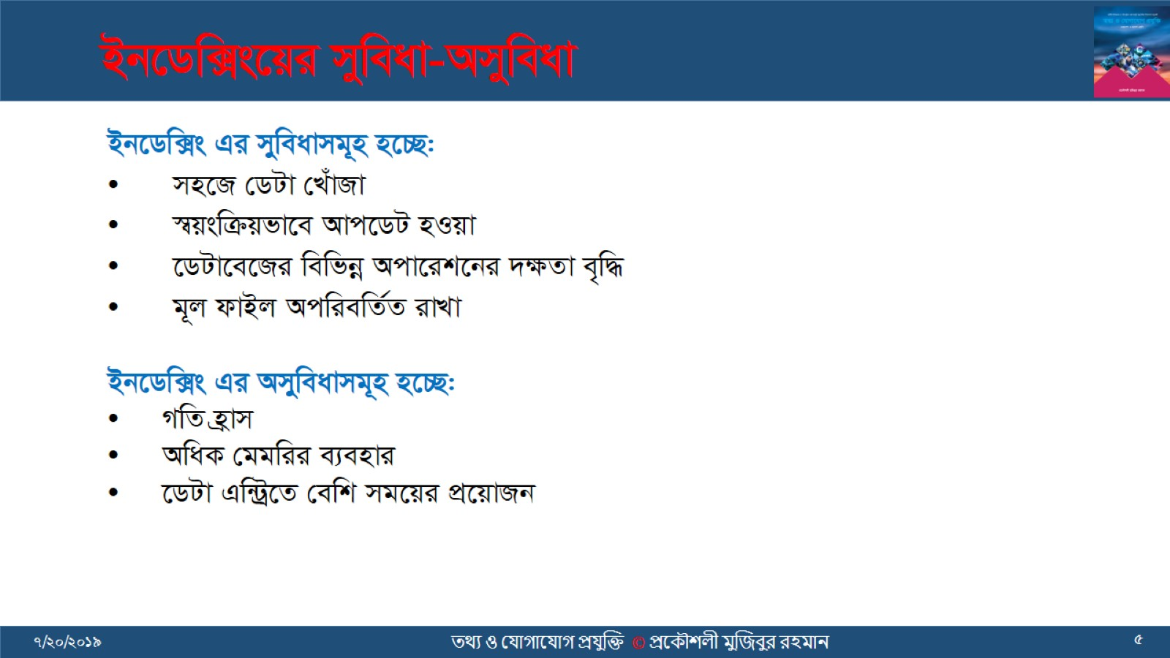
Bb‡Ww·s‡qi myweav-Amyweav

Slide 6
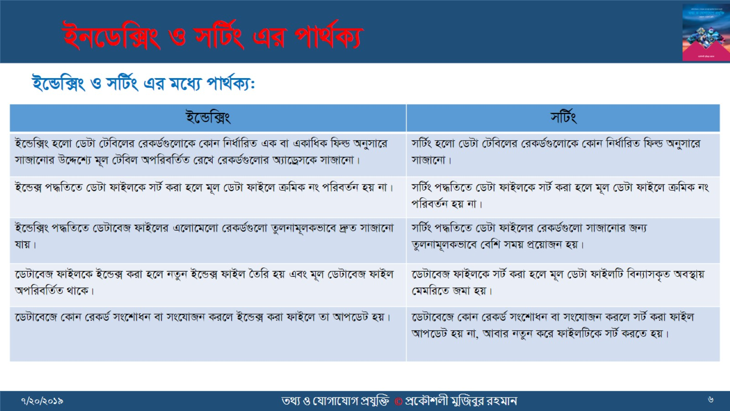
Bb‡Ww·s I mwU©s Gi cv_©K¨

Slide 7
